Slide 1
Token Budget Orchestration Strategies for Web Agents
A
B
C
Thomas Beard | Student number 220008104
MSc in Artificial Intelligence, City St George's, University of London, 2026
Supervisor: Professor Eduardo Alonso
Notes:
[Slide 1 · Title · ~15s]
Hello, I'm Thomas Beard, and this is my MSc Artificial Intelligence project, Token Budget Orchestration Strategies for Web Agents, supervised by Professor Eduardo Alonso. I will explain the problem, show the system running, walk through the key code, and present the results and what I learned.

Slide 2
Why orchestration becomes a budget problem on the web
One step of a web task
The gap this project fills
A
Page (a11y tree)
1 model call
Action
Orchestration (multi-agent pipelines) improves quality on short tasks such as question answering and code.
A web agent re-observes a large page at every step, so pipeline overhead grows with episode length.
Budget-matched comparisons have changed conclusions elsewhere, but have not been run on a stateful web benchmark with paired statistics.
Nobody has learned, from logged web episodes, when orchestration is worth paying for.
Question: under a fixed token budget, does orchestration still pay, and can a learned router decide when it does?
B
Page (a11y tree)
Planner
Executor
Critic
Each call re-sends the same page and its own instruction block; the cost repeats at every step of an episode of up to 25 steps.
×3
~2,050
812
model calls per step in a Planner → Executor → Critic pipeline
instruction tokens carried on every pipeline step
realistic tasks in WebArena, on self-hosted sites
Notes:
[Slide 2 · The problem · ~45s]
Web agents are language models that browse websites to complete tasks: find a product, change an order, post on a forum. A popular way to improve them is orchestration: a pipeline of roles, planner, executor and critic, each a separate model call. On short tasks this raises quality. [Point to the diagram on the left.] But a web agent sees a new page at every step and re-sends it on every call, so a three-role pipeline makes three calls per step on the same page, each carrying about two thousand tokens of instructions, and the overhead repeats at every step. [Point to the card on the right.] Nobody had asked whether orchestration still pays when the token budget is fixed, on a realistic, stateful web benchmark. That is the gap this project fills.

Slide 3
Three orchestration strategies under one fixed budget
A
Single agent (baseline)
B
Fixed pipeline
C
Learned router (my contribution)
1 model call per step
3 model calls per step
A's or B's machinery, plus two decisions
One prompt: goal, URL, last error, last eight actions, page
Chooses one action and justifies it
Budget check before every step (Equation 3.1)
Planner writes sub-goals
Executor picks the action
Critic approves or revises it
Same page sent three times
Mode head: once per episode, run A or B
Stop head: before every step, continue or stop
Trained offline (AWR + entropy) on logged A and B episodes
Never interacts with the sites during training
Shared by all three: BrowserGym/WebArena harness, GPT-5 mini (low reasoning effort), the same prompt skeleton, guards and token accounting. Only the orchestration varies.
Notes:
[Slide 3 · Three strategies · ~45s]
I compared three strategies, the three cards. Strategy A, in blue, is the baseline: a single agent, one model call per step. Strategy B, in orange, is a fixed pipeline: a Planner writes sub-goals, an Executor chooses the action and a Critic reviews it, three calls per step. Strategy C, in green, is my contribution: a router trained with offline reinforcement learning on the logged episodes of A and B. It decides once per episode which mode to run and, before every step, whether to stop and keep the remaining budget. [Point to the line at the bottom.] All three share the same harness, the same model, GPT-5 mini, and the same budget enforcement, so only the orchestration varies. These colours mark A, B and C in every chart that follows.

Slide 4
Research questions and the objectives' pass tests
Research questions
Objectives and their tests
RQ1
How do success rate, token efficiency and the error profile vary with a fixed global token budget across the three strategies?
1
Harness All three strategies run end to end on self-hosted WebArena; every episode respects its cap, overshoot measured.
2
Dataset Full task × budget coverage; difficulty, risk and eligibility labels; LLM difficulty labels agree with a 50-task gold set (Cohen's κ).
RQ2
How do the strategies differ in sensitivity to task difficulty (Easy / Medium / Hard) in success rate and failure modes?
3
Router Offline replay keeps ≥ 90% of A's successes while saving tokens; then runs live as Strategy C.
4
Analysis Every claimed difference backed by a paired exact McNemar test with multiple-comparison correction and 95% CIs.
RQ3
Given the same budget, how do intra-episode allocation schemes (even, front-loaded, reactive) affect success and token efficiency?
5
Reproducibility Repository with the full pipeline and documented schemas for every dataset.
Notes:
[Slide 4 · Research questions and objectives · ~35s]
Three research questions, on the left. RQ1: how do success, token efficiency and the failure profile change with a fixed budget? RQ2: how sensitive is each strategy to task difficulty? RQ3: within one budget, does the way tokens are spread across the steps matter? [Point to the right column.] Each of the five objectives had a pass test fixed in the proposal: for example, the router had to keep at least ninety percent of the single agent's successes in cross-validated replay.

Slide 5
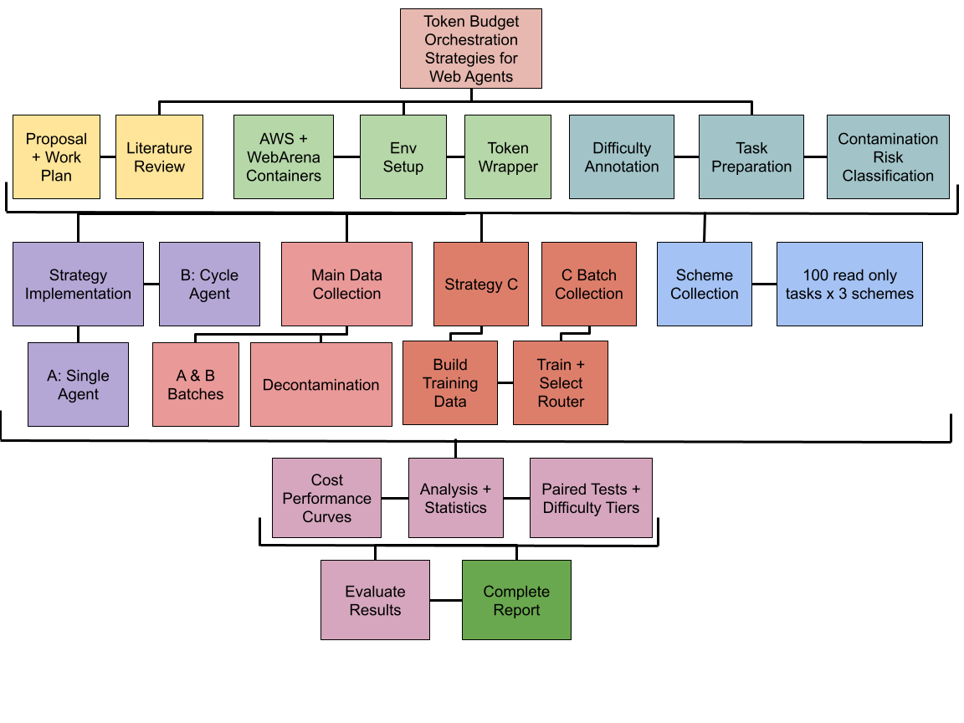
Scope, work plan and the outputs produced
Scope
475 single-site WebArena tasks (shopping 187, shopping admin 182, forum 106) × 6 budgets (2k to 64k tokens) × 3 strategies = 8,550 episodes, plus 900 RQ3 scheme episodes.
Outputs
1
Shared harness: wa_env.py + strategy_a/b/c.py with hard per-episode token caps
2
Annotated dataset: 9,450 episodes, ~116 M tokens, with difficulty, risk and eligibility labels
3
Trained router: Strategy C's mode and stop heads with their training data (router_c_models)
4
Analysis pipeline: Cost-performance curves, paired McNemar tests, bootstrap intervals
5
Report and repository: Reproduction guide, schemas and all tables regenerated from scripts
Report Figure 1.1: work plan through four milestones (environment, dataset, router, analysis)
Repository: github.com/Tbeard04/Token-Budget-Orchestration-Strategies-for-Web-Agents
Notes:
[Slide 5 · Scope and outputs · ~40s]
The scope is the 475 single-site WebArena tasks on a shopping site, a shop-admin panel and a forum, each run at six budgets from two thousand to sixty-four thousand tokens by each strategy: 8,550 episodes, plus 900 for the allocation schemes. [Point to the work plan on the left, Figure 1.1.] Four milestones: environment, dataset, router, analysis. [Point to the numbered list.] The outputs: a shared harness, an annotated dataset of 9,450 episodes, the trained router with its training data, the analysis pipeline with paired statistics, and the report with a reproduction guide. Everything is in the public repository linked at the bottom.

Slide 6
How the study was built
Harness and task scope · Token accounting · Strategy C · Decontamination · Difficulty annotation
Notes:
[Slide 6 · Divider: methodology · ~5s]
First, how the study was built.

Slide 7
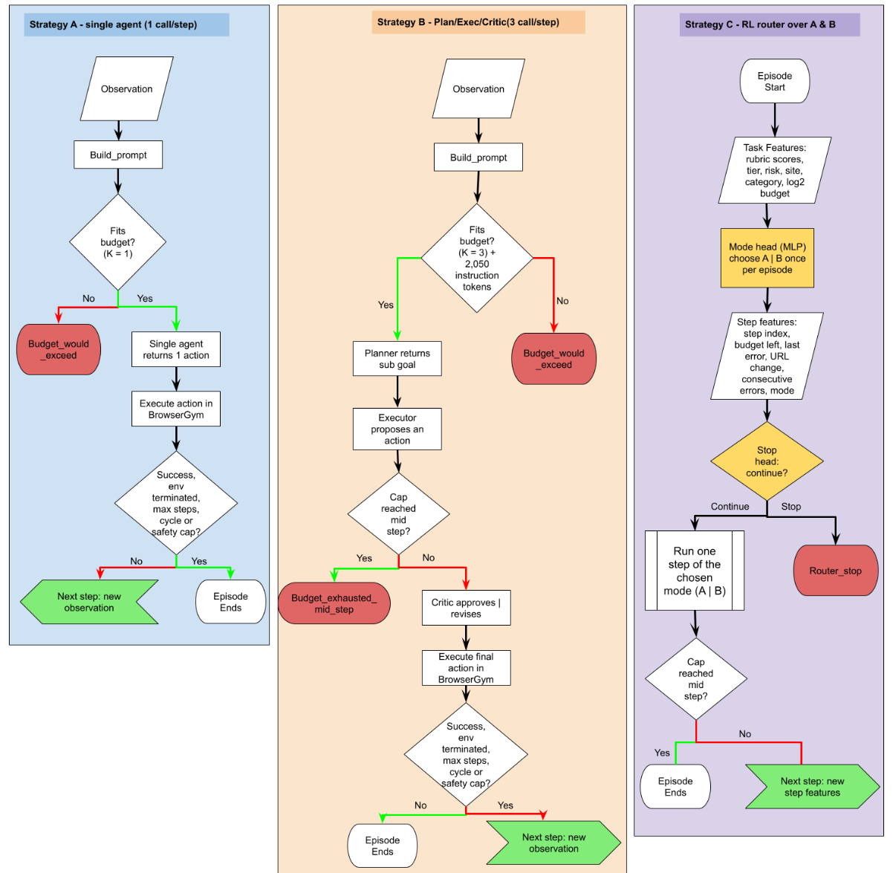
One harness, three control flows
E
Environment
WebArena sites as Docker containers on one AWS EC2 t3a.xlarge (shopping :7770, admin :7780, forum :9999); sites rebuilt before each strategy's collection.
B
Browser
BrowserGym 0.14.2 + Playwright: reset() loads the task, step(action) returns the next accessibility tree and WebArena's reward.
M
Model and agents
Pydantic AI typed outputs (justification + one action); GPT-5 mini with reasoning effort pinned to low; token counts reported by the API.
T
Task scope
475 single-site tasks: shopping 187, shopping admin 182, forum 106 (GitLab, map and multi-site tasks excluded; Report Table 3.1).
G
Guards
25-step ceiling, four consecutive action errors, same action from the same page three times.
Report Figure 3.1: per-step control flow of Strategies A, B and C
Notes:
[Slide 7 · Harness · ~35s]
[Point to Figure 3.1 on the left.] Every strategy follows the same loop: observe the page as an accessibility tree, build a prompt, call the model, execute the action and check the guards. A makes one call per step, B three, and C inserts the router's stop check before each step and chooses A's or B's path at the start. [Point to the right column.] The shared components: WebArena's sites run as Docker containers on one AWS instance, BrowserGym and Playwright drive the browser, and Pydantic AI enforces a typed output, a justification plus one action, and reports the token counts the accounting uses.

Slide 8
Token accounting: enforced before and after every call
Equation 3.1 ĉ_{t} = k · ⌈ |x_{t}| / 4 ⌉ + m_{out} + m_{instr} proceed only if C_{t−1} + ĉ_{t} ≤ B
|x_t| prompt length in characters (4 characters per token), k calls in the step, m_out and m_instr reserves for outputs and instruction blocks, C_t−1 tokens already spent, B the budget.
k = 1, no reserves
Termination reason | Fires when | Failure class
success | WebArena's evaluator returns reward 1 | Success
env_terminated | An answer is submitted and judged wrong | Wrong answer
budget_would_exceed | Pre-step estimate would exceed the cap | Budget exhausted
safety_token_cap | Running total reaches the cap after a call | Budget exhausted
budget_exhausted_mid_step | Cap reached between B's three calls | Budget exhausted
navigation_cycle | Same action from the same page 3 times | Stuck (guard)
repeated_action_failure | Four consecutive action errors | Stuck (guard)
router_stop | Strategy C's stop head ends the episode | Router stop
A
Estimate covers the prompt only, so the final step can overshoot by its output; the post-call check then ends the episode (overshoot bounded to one step).
B
k = 3, m_out = 900, m_instr ≈ 2,050
Three prompts and three instruction blocks must fit before the step starts; otherwise budget_would_exceed with zero spend.
C
Whichever mode the router chose
Plus a router_stop before any step when the stop head fires.
Report Table 3.3 (Appendix): termination reasons and failure classes
Notes:
[Slide 8 · Token accounting · ~35s]
Budgets are enforced twice per step. [Point to Equation 3.1.] Before each step the cost is estimated from the prompt length, four characters per token, times the number of calls, plus reserves for outputs and instruction blocks; if the step would not fit, the episode ends with budget_would_exceed before anything is spent. After each call the running total is compared with the cap. [Point to the three cards.] A has one call and no reserves; B three calls and about two thousand instruction tokens. [Point to the table.] Every termination reason maps to a failure class, which the results use.

Slide 9
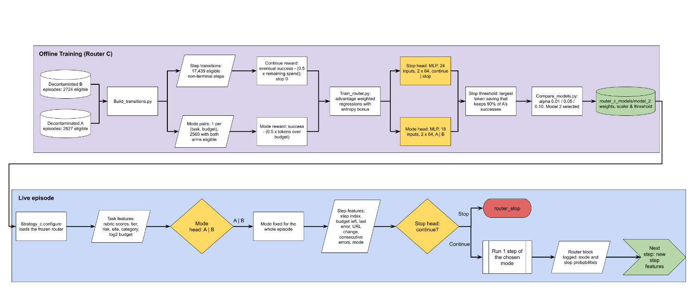
Strategy C: two small heads trained offline, consulted live
Training
Data: decontaminated A and B episodes → 2,560 mode pairs, 17,439 step transitions
Two MLPs (2 × 64 ReLU): mode head 18 features, stop head 24 features
Advantage-weighted regression with entropy weight α; 5 task-level folds
Stop threshold = largest saving that keeps ≥ 90% of A's successes
Model | α | Kept | Saved
1 | 0.01 | 91.2% | 22.4%
2 (selected) | 0.05 | 91.8% | 22.0%
3 | 0.10 | 91.0% | 22.1%
Report Figure 3.2: offline training of the mode and stop heads and their use in a live episode
Live: the mode head decides once per episode (execute = A, cycle = B); the stop head is consulted before every step and ends the episode with router_stop, spending nothing further.
Report Table 3.5 (Appendix): offline replay, relative to always running A
Notes:
[Slide 9 · Strategy C · ~35s]
[Point to the top half of Figure 3.2.] Offline, the decontaminated A and B episodes become training data: 2,560 task-budget pairs for the mode head and 17,439 step transitions for the stop head. Both heads are small MLPs trained by advantage-weighted regression with entropy regularisation, in five task-level folds, so no router is tested on a task it saw. [Point to the table.] Of three routers trained, model 2 was selected: 91.8 percent of A's successes kept for 22 percent fewer tokens in replay, passing the ninety-percent test. [Point to the bottom half.] Live, the mode head is consulted once and the stop head before every step.

Slide 10
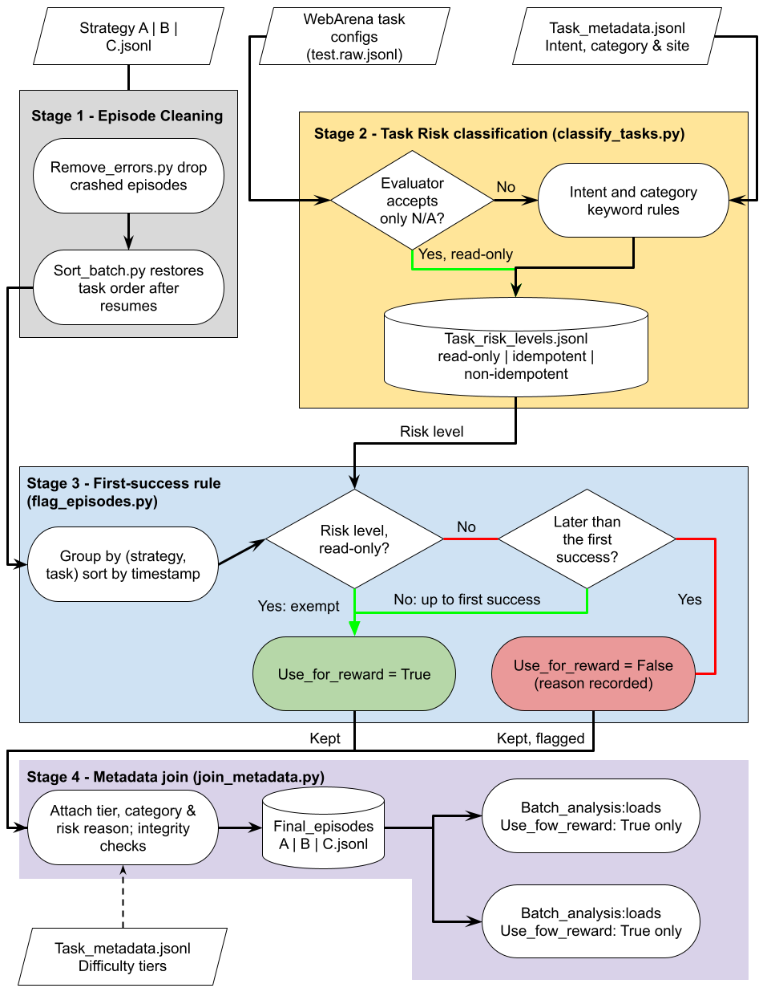
Collection and decontamination of a stateful benchmark
Why it is needed
WebArena's sites keep state between episodes and every task is attempted six times per strategy. After a success on a state-changing task, later attempts find the work already done. Rule: within each (strategy, task) group, episodes after the first success on an idempotent or non-idempotent task are flagged ineligible; read-only tasks are exempt.
Run | Dates (2026) | Episodes | Tokens | Eligible
Strategy A, main grid | 29 Jul – 12 Aug | 2,850 | 29.5 M | 2,627 (92.2%)
Strategy B, main grid | 7 – 12 Aug | 2,850 | 44.3 M | 2,723 (95.5%)
Strategy C, main grid | 25 – 28 Sep | 2,850 | 23.7 M | 2,604 (91.4%)
Spending schemes (RQ3) | 28 – 29 Sep | 900 | 18.4 M | 900 (read-only)
Report Table 3.6 (Appendix): the collection runs
Site | Read-only | Idempotent | Non-idempotent | Total
Shopping | 131 | 21 | 35 | 187
Shopping admin | 101 | 0 | 81 | 182
Forum | 11 | 15 | 80 | 106
Total | 243 (51%) | 36 (8%) | 196 (41%) | 475
Report Figure 3.3: the decontamination pipeline
Report Table 3.7 (Appendix): contamination-risk level by site
Notes:
[Slide 10 · Data pipeline · ~30s]
WebArena's sites keep state between episodes, so a success on a state-changing task can make later repeats trivial. [Point to Figure 3.3 on the left.] Every task gets a contamination-risk level; crashed episodes are removed; and after the first success on a state-changing task, that strategy's later episodes are flagged ineligible before the difficulty metadata is joined. [Point to the upper table.] Four collection runs, about 116 million tokens, with the episodes that survived decontamination. [Point to the lower table.] About half of the tasks are read-only and cannot be contaminated at all.

Slide 11
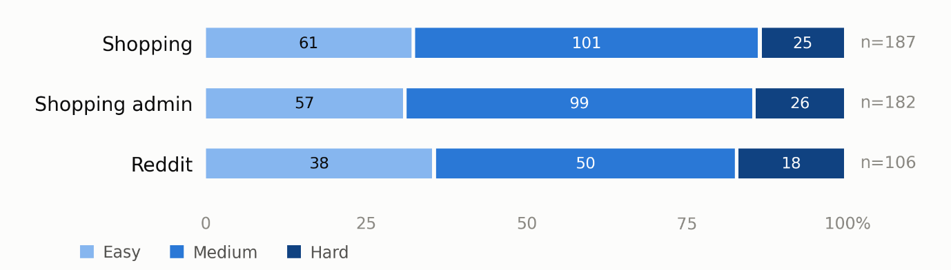
Difficulty labels independent of how the agents fared
Rubric (Report Table 3.8)
Measure | Held out (n = 30) | Exemplars (n = 20) | All (n = 50)
Pages to traverse | 0.43 | 0.79 | 0.64
Retrieval type | 0.60 | 0.88 | 0.77
Interaction | 0.74 | 0.85 | 0.80
Target locatability | 0.76 | 0.93 | 0.85
Mean of four dimensions | 0.63 | 0.87 | 0.76
Tier agreement (exact) | 67% | 90% | 76%
Four dimensions scored 0 to 2: pages to traverse, retrieval type, interaction, target locatability
Total 0 to 8 banded into Easy (0–2), Medium (3–5), Hard (6–8)
Scored by an LLM annotator (GPT-5 mini, typed output) from the task's intent and evaluation criteria; template siblings harmonised
Validated against 50 hand-labelled tasks: 20 shown as exemplars, 30 held out
Report Table 3.9 (Appendix): agreement between hand labels and the LLM annotator
156
250
69
Easy tasks (33%)
Medium tasks (53%)
Hard tasks (15%)
Report Figure 3.4: difficulty tier by site
Notes:
[Slide 11 · Difficulty annotation · ~30s]
RQ2 needs a difficulty label that does not depend on how the agents fared. [Point to the rubric.] Each task was scored on four dimensions by an LLM annotator and banded into Easy, Medium and Hard. [Point to the table at the top right.] Against my own hand labels, the mean quadratic-weighted kappa was 0.63 on thirty held-out tasks, substantial agreement, with pages-to-traverse the weakest dimension. [Point to Figure 3.4.] The result: 156 Easy, 250 Medium and 69 Hard tasks, spread similarly across the sites.

Slide 12
Demonstration
The software running | An episode record | Analysis Output | Code walkthrough
Notes:
[Slide 12 · Divider: demonstration · ~5s]
Now the demonstration: the software running, then the two pieces of code that matter most.

Slide 13
On screen: an episode, its record and the analysis
1
Run one episode
2
Inspect the episode record
3
Regenerate the results
python strategy_a.py --budget 16000 276
data/demo/strategy_a.jsonl
data/processed/decontaminated/../final_episodes_a.jsonl
python -m batch_analysis.compare_abc --a … --b … --c …
Terminal prints each step: reasoning, action, URL, tokens in / out and the cumulative total
Watch the pre-step budget check and the final termination reason
Same command shape for strategy_b.py and strategy_c.py
One JSON object per episode: task, site, goal, budget, success, reason, steps, tokens
Per-call step log (role, action, URL, error, tokens)
Decontamination fields: risk level, eligibility flag, difficulty tier
Prints the success-by-budget table, McNemar tests and tier breakdowns
Writes the figures used in the results chapter (cost_curve, outcome_mix, difficulty)
analyse_a/b/c.py and analyse_schemes.py give the per-strategy and RQ3 tables
Screen recording follows: terminal and editor on the AWS instance, then the analysis output on the local machine.
Notes:
[Slide 13 · Software demonstration (screen recording) · ~80s]
I will switch to the screen now. [Card 1, terminal.] This is one episode of Strategy A at a sixteen-thousand-token budget, task 276, started with strategy_a.py. For each step the terminal prints the model's justification, the chosen action, the URL, and the tokens in and out with the cumulative total. Notice the pre-step check and, at the end, the termination reason and the final count, which never exceeds the cap. [Card 2, editor.] Each episode is appended as one JSON record: task, budget, success, reason, tokens and the step log, plus the decontamination fields. [Card 3, terminal.] Finally compare_abc.py reads the three decontaminated files and prints the tables and figures you are about to see. Every table in the report comes from these printouts.

Slide 14
Key feature 1: the pre-step budget check in strategy_a.py
for i in range(W.MAX_STEPS):
prompt = W.build_prompt(obs, action_history, url_history)
# Check BEFORE paying: never exceed the stated budget.
spent = in_tok + out_tok
est_in = len(prompt) // 4 # 4 characters per token
if spent + est_in > cap:
reason = "budget_would_exceed"
break # episode ends, nothing spent
result = W.call_agent(agent, prompt) # one model call
u = result.usage()
in_tok += u.input_tokens # counts reported by the API
out_tok += u.output_tokens # reasoning tokens included
total = in_tok + out_tok
decided = result.output # typed: reasoning + action
action_history.append(decided.action)
...
if total >= cap: # post-call check
reason = "safety_token_cap"; break
1
Estimate before paying
Equation 3.1 with k = 1: the prompt about to be sent is measured in characters and divided by four. Nothing is charged until the step is known to fit.
2
Skip, do not spend
If the estimate would cross the cap the loop breaks with budget_would_exceed. This is why Strategy B, whose estimate includes three prompts and 2,050 instruction tokens, never starts at 2k or 4k.
3
Count what the API reports
Input and output tokens come from the usage object, with hidden reasoning tokens included; the post-call check bounds any overshoot to one step.
src/strategy_a.py, lines 115–167
Notes:
[Slide 14 · Code walkthrough: budget check · ~45s]
This is the key feature of the harness: the budget check in strategy_a.py, which implements Equation 3.1. [Point to the highlighted lines.] On every step the prompt is built, the tokens spent so far are summed, and the input cost is estimated at four characters per token. If spent plus the estimate exceeds the cap, the step is skipped and the episode ends with budget_would_exceed before any money is spent. That one line is why the pipeline never starts at two or four thousand tokens. Otherwise the model is called and the usage reported by the API, reasoning tokens included, is added to the running total; a post-call check ends the episode if the cap is reached. [Debugger.] Stopping at the if statement on a real step shows est_in, spent and cap.

Slide 15
Key feature 2: the router's two decisions in strategy_c.py
# Episode start: the mode head decides once
task_row = {**tasks[task_id], "budget_level": cap}
mode, p_cycle = router.choose_mode(task_row)
# p_cycle from mode_net(task_features); "cycle" if >= 0.5 else "execute"
1
Mode head, once
18 task features (site, category, difficulty scores, budget) give p_cycle. In the live run it chose the pipeline in 5 of 2,604 episodes.
src/strategy_c.py, lines 150–157
# Before every step: the stop head decides whether to continue
spent = in_tok + out_tok
state = {**task_row, "step_index": i,
"budget_remaining_frac": 1 - spent / cap,
"last_error": int(last_error),
"url_changed_last": int(url_changed),
"consecutive_errors": consecutive_errors, "mode": mode}
p_stop = router.p_stop(state)
stop = p_stop >= router.threshold # threshold fixed offline
decisions.append({"step": i, "p_stop": p_stop, "stop": stop, ...})
if stop:
stop_step = i
reason = "router_stop" # spend nothing further
...
# otherwise run A's single call or B's Planner -> Executor -> Critic cycle
2
Stop head, every step
24 features add the step index, budget remaining, last error and whether the page changed. The threshold was fixed offline at the largest saving keeping 90% of A's successes.
3
Everything is logged
p_cycle, every p_stop and the stop step go into the episode record, so the analysis can later show what the router did and when.
src/strategy_c.py, lines 198–220
Notes:
[Slide 15 · Code walkthrough: router · ~45s]
And the router, in strategy_c.py. [Point to the top block.] At the start of the episode, choose_mode runs the mode network on the task's features and returns cycle or execute, with the probability logged. [Point to the bottom block.] Before every step a state is built from the step index, the fraction of budget remaining, the last error and whether the URL changed. p_stop comes from the stop network, and if it meets the threshold learned offline, the episode ends with router_stop and spends nothing further. Otherwise the step runs through A's single call or B's three-call cycle, unchanged. [Point to card 3.] Every decision is appended to the episode record, which is how the analysis can later show what the router did, and when.

Slide 16
Results
RQ1 cost and performance | Failure modes and the Critic | RQ2 difficulty | RQ3 allocation schemes
Notes:
[Slide 16 · Divider: results · ~5s]
The results, in the order of the three research questions.

Slide 17
The eligible dataset: two properties that drive everything
Strategy | Episodes kept (excluded) | Successes | Success rate [95% CI] | Tasks solved (any budget) | Median tokens / step | Tokens / success
A single agent | 2,627 (223) | 383 | 14.6% [13.3, 16.0] | 171 / 475 (36%) | 2,480 | 73,490
B fixed pipeline | 2,723 (127) | 226 | 8.3% [7.3, 9.4] | 120 / 475 (25%) | 6,967 | 193,544
C routed | 2,604 (246) | 360 | 13.8% [12.6, 15.2] | 157 / 475 (33%) | 2,490 | 63,393
Report Table 4.1: the eligible dataset by strategy (analyse_a/b/c.py, compare_abc.py)
2.8×
2,599 / 2,604
7,954
a Strategy B step costs 2.8 times a Strategy A step (6,967 vs 2,480 tokens): three calls on the same page plus 2,050 instruction tokens
episodes in which C's mode head chose the single-agent mode, so C's per-step cost equals A's
eligible main-grid episodes after decontamination (4.5% to 8.6% excluded per strategy)
Budget-driven failures: A 56% of episodes, B 86%. Successful episodes were cheap: A median 6,570 tokens over two steps; a successful B episode cost 1.8 times as much.
Notes:
[Slide 17 · Dataset and per-step cost · ~30s]
[Point to Table 4.1.] After decontamination, between 2,600 and 2,700 eligible episodes per strategy; pooled over budgets, A succeeded on 14.6 percent, B on 8.3 and C on 13.8. Two properties drive everything that follows. [Point to the first large number.] A Strategy B step costs 2.8 times a Strategy A step, 6,967 tokens against 2,480: three calls on the same page plus the instruction blocks. [Point to the second.] C's per-step cost equals A's, because its mode head chose the single-agent mode in 2,599 of 2,604 episodes.

Slide 18
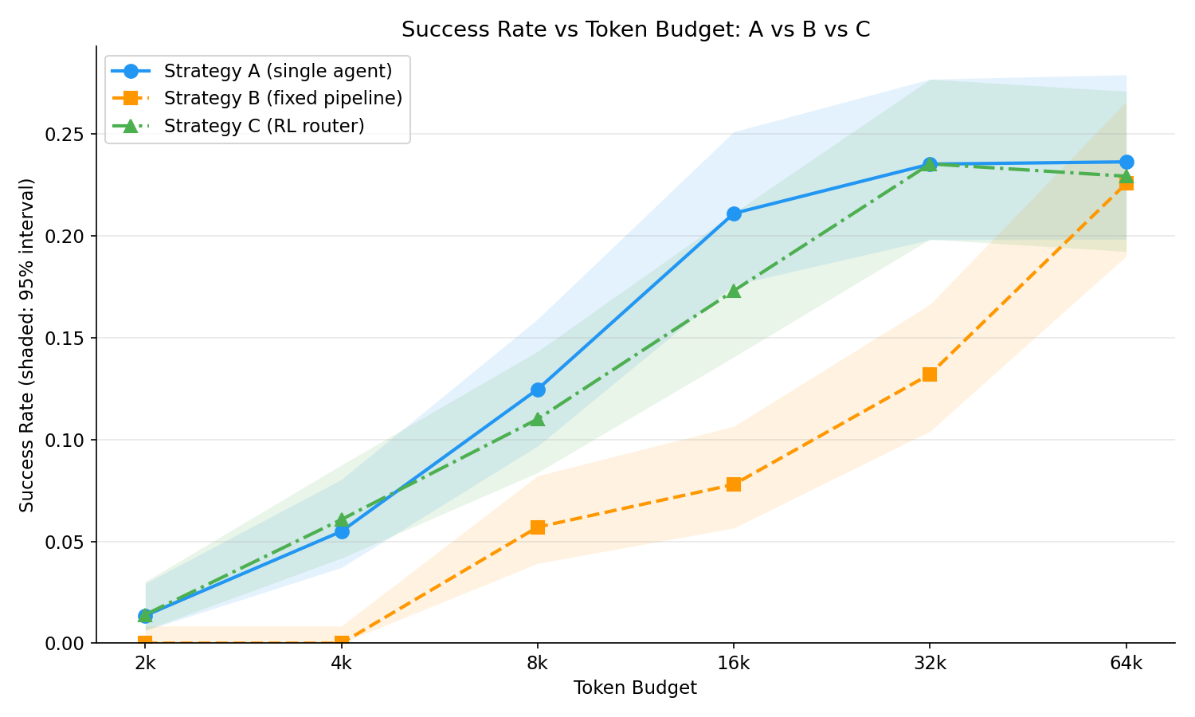
RQ1: success against the fixed budget
Budget | A | B | C
2k | 1.4% | 0.0% | 1.4%
4k | 5.5% | 0.0% | 6.1%
8k | 12.5% | 5.7% | 11.0%
16k | 21.1% | 7.8% | 17.3%
32k | 23.5% | 13.2% | 23.5%
64k | 23.6% | 22.6% | 22.9%
Report Table 4.2 (condensed): success rate by budget; CIs in the report
Paired exact McNemar tests (Table 4.4)
A > B: 192 cells A only vs 24 B only, p < 0.0001
C > B: 183 vs 34, p < 0.0001
A vs C: 83 vs 60, p = 0.065 (not distinguishable)
B needed 2 to 4 times the budget to match A: B at 64k ≈ A at 32k; B at 32k ≈ A at 8k
Report Figure 4.1: success rate against token budget with Wilson 95% bands (compare_abc.py)
Notes:
[Slide 18 · RQ1 cost curve · ~40s]
Figure 4.1 answers RQ1. [Point to the blue curve.] The single agent rises steeply and flattens from sixteen thousand tokens at about twenty-three percent. [Point to the orange curve.] The pipeline solves nothing at two and four thousand, because a single step does not fit, and trails A by seven to thirteen points up to thirty-two thousand; the curves meet only at sixty-four thousand, where the budget stops binding. [Point to the green curve.] The router tracks A inside the confidence band at every budget. [Point to the box.] A beats B and C beats B at p below 0.0001; A and C are not distinguishable. Matching A's success cost B two to four times the budget.

Slide 19
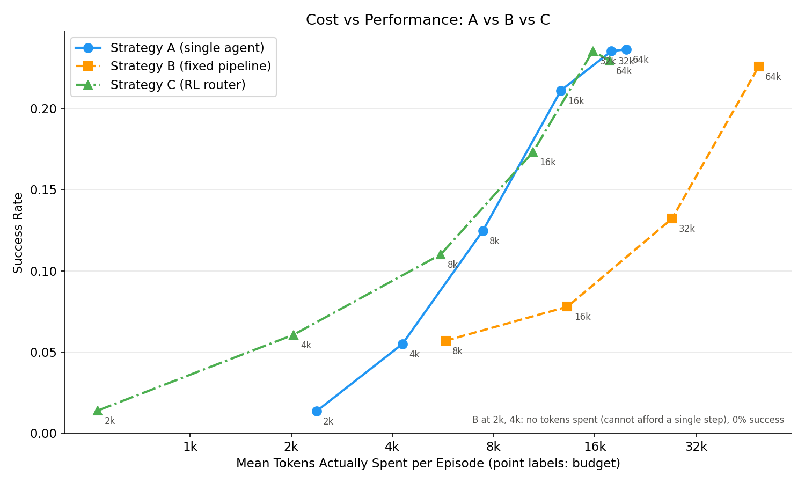
RQ1: what the tokens actually bought, and what the router kept
Policy | Successes | Kept | Tokens | Saved
Always A | 352 | 100% | 26.58 M | 0%
Always B | 190 | 54% | 39.45 M | −48%
Strategy C (live router) | 329 | 93% | 21.36 M | 20%
Oracle (hindsight) | 372 | 106% | 3.44 M | 87%
Report Table 4.3: C against fixed policies on the 2,463 cells all three attempted
93%
20%
of A's successes kept by the live router (offline prediction 91.8%)
fewer tokens than always running A (offline prediction 22.0%)
Report Figure 4.2: success against mean tokens actually spent per episode; labels give the budget
A and C climb the same spend curve; B reaches each success level at 2 to 4 times the spend
On cells both solved, B spent a median 2.90× A's tokens; C spent 1.00×
The saving came from the stop head: 838 stops, 703 before any action; stop rate 77% at 2k, 8.5% at 64k
Offline training transferred to live operation within two points on both axes; Objective 3's 90% test passed live as well as offline.
Notes:
[Slide 19 · Spend and Strategy C · ~35s]
[Point to Figure 4.2.] The same successes against the tokens actually spent: A and C climb the same curve, while B reaches each level of success only at two to four times the spend. [Point to Table 4.3.] On the 2,463 cells all three attempted, the live router kept 93 percent of A's successes for 20 percent fewer tokens, within two points of the offline prediction, so the training transferred to live operation. [Point to the last row.] The hindsight oracle shows how much a better stop decision could still recover. Almost all of the saving came from the stop head declining hopeless cells before any action was taken.

Slide 20
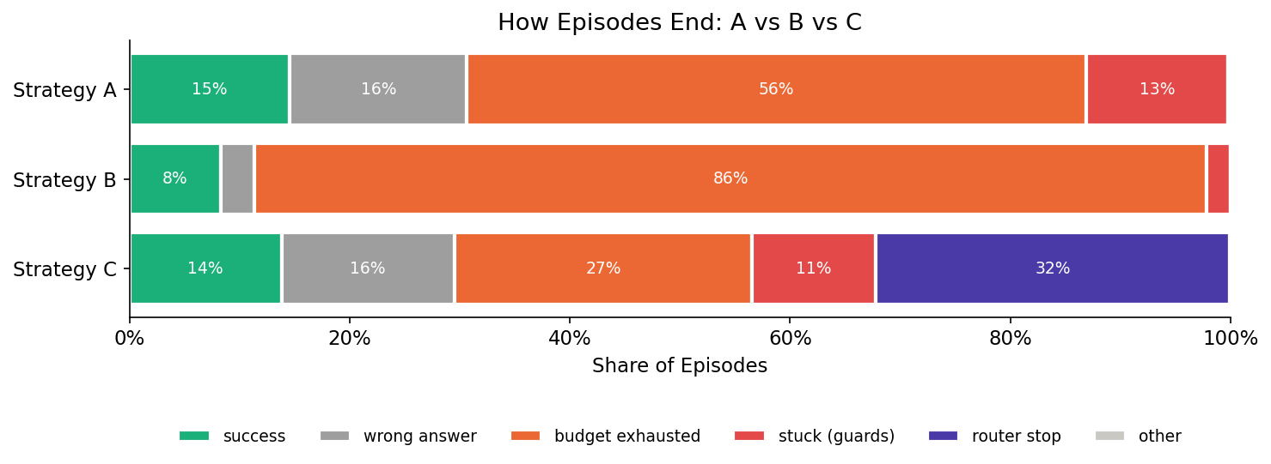
RQ1: how episodes ended
Report Figure 4.4: termination class as a share of eligible episodes per strategy (compare_abc.py)
A
66%
of A's 2,244 failures were budget-driven; 19% wrong answers; 15% guard stops (loops)
B
94%
of B's 2,497 failures were budget-driven; it rarely reached a wrong answer (3%) or a loop (2%)
C
37%
of C's failures were router stops; budget exhaustion fell to 31%. 838 stops, 703 at step 0; on attempted episodes success beat A's at 5 of 6 budgets
Notes:
[Slide 20 · Failure modes · ~30s]
[Point to Figure 4.4.] How episodes ended. Two-thirds of A's failures were budget exhaustion, the rest wrong answers and guard stops. B's failures were ninety-four percent budget-driven; it rarely got far enough to answer wrongly. [Point to the purple segment.] For C, the router replaced about half of A's budget exhaustion with a cheaper, earlier exit: 838 stops, 703 before any action. On the episodes it allowed to proceed, success beat A's at five of the six budgets, which is what removing mostly hopeless episodes should produce.

Slide 21
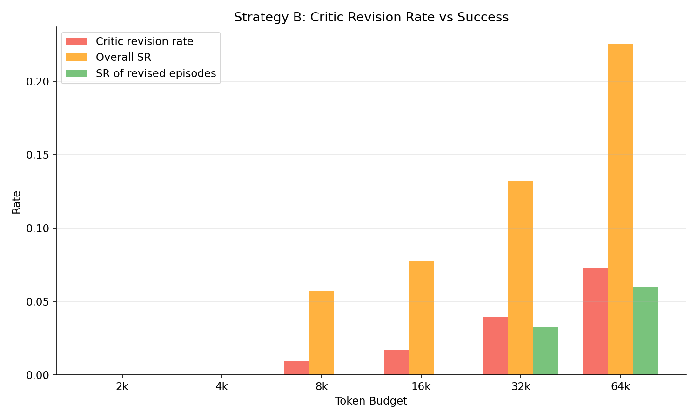
What the Critic was worth in the fixed pipeline
5.1%
31.5%
of 6,263 Critic calls changed the Executor's action (322 revisions)
of everything B spent went on review; 29.7% on approvals that changed nothing
95%
2.6×
of B's 226 successes involved no revision at all
lift: revisions were 2.6 times more likely after an action error, the one useful signal
Episodes containing a revision succeeded less often than those without (4.8% vs 8.6%). A reviewer that reads the same page as the actor has little independent information: review paid on every step is overhead, not safety.
Report Figure 4.6: Critic revision rate, overall success and success of revised episodes, by budget (analyse_b.py)
Notes:
[Slide 21 · The Critic · ~30s]
[Point to Figure 4.6.] Inside the pipeline, the Critic. The red bars are its revision rate: called 6,263 times, it changed the action 5.1 percent of the time. [Point to the numbers on the right.] Review consumed 31.5 percent of everything B spent; 95 percent of B's successes involved no revision; and episodes containing a revision succeeded less often. The one signal that predicted a useful revision was a preceding action error. A reviewer reading the same page as the actor has little independent information: review paid on every step is overhead, not safety.

Slide 22
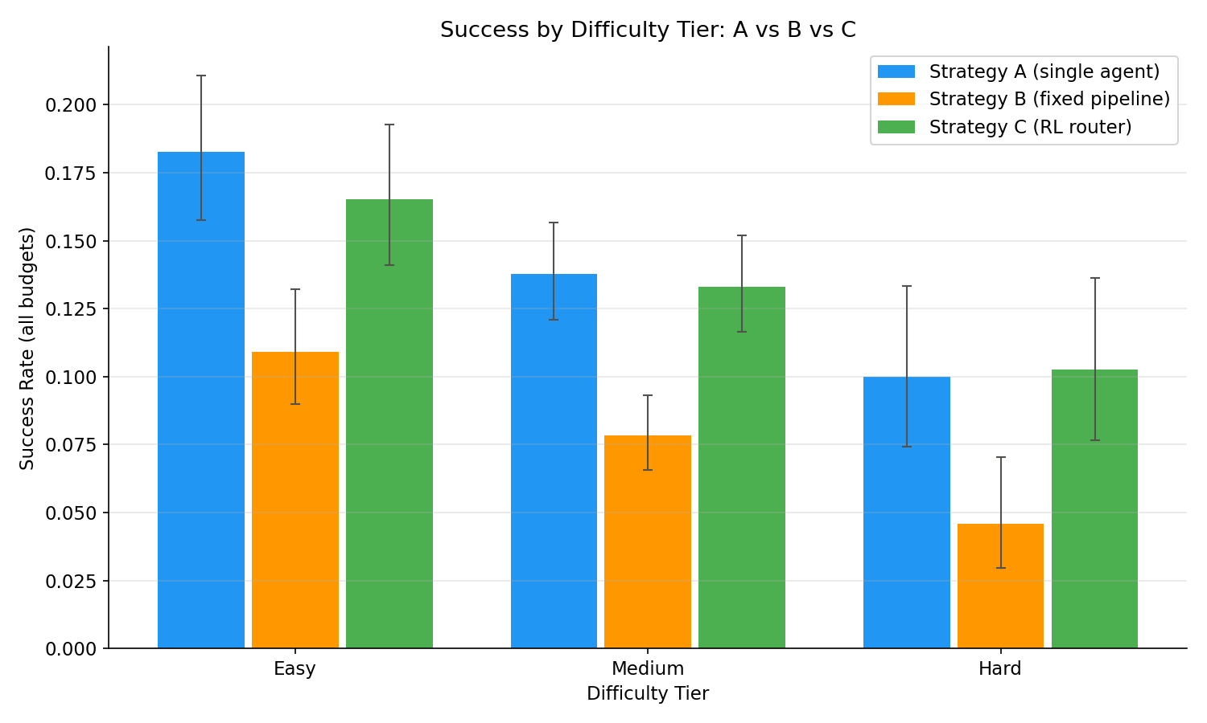
RQ2: sensitivity to task difficulty
Tier (n A / B / C) | A | B | C
Easy (805 / 842 / 793) | 18.3% | 10.9% | 16.5%
Medium (1,422 / 1,467 / 1,412) | 13.8% | 7.8% | 13.3%
Hard (400 / 414 / 399) | 10.0% | 4.6% | 10.3%
Hard / Easy ratio [CI] | 0.55 [0.25, 0.94] | 0.42 [0.13, 0.86] | 0.62 [0.28, 1.09]
Report Table 4.5 (condensed): success by tier pooled over budgets
Same ordering in every tier: A > B and C > B (p < 0.0001 each, threshold 0.0056); A vs C never differs (p = 0.058, 0.434, 1.000)
Paired sensitivity differences: C − B +0.20 [+0.01, +0.44] excludes zero; B − A and C − A do not
The router declined 46% of Hard tasks against 27% of Easy: its stop head learned where A's success was lowest
B overtook A only on Easy tasks at 64k (31.3% vs 30.1%); 15 tasks were solved by B and never by A, where A looped rather than ran out of budget
Report Figure 4.5: success rate by difficulty tier with Wilson 95% intervals (compare_abc.py)
Notes:
[Slide 22 · RQ2 difficulty · ~35s]
[Point to Figure 4.5.] RQ2. Every strategy fell from Easy to Hard, and the ordering held in every tier: blue above green above orange. [Point to the last row of the table.] Hard-tier success as a share of Easy-tier success was 0.55 for A, 0.42 for B and 0.62 for C; only the C-against-B contrast is supported, plus 0.20 with an interval excluding zero. The pipeline was the most difficulty-sensitive strategy and the router the least, and the reason is in the data: the stop head declined forty-six percent of Hard tasks against twenty-seven percent of Easy ones. It learned to decline the tasks on which the single agent was weakest.

Slide 23
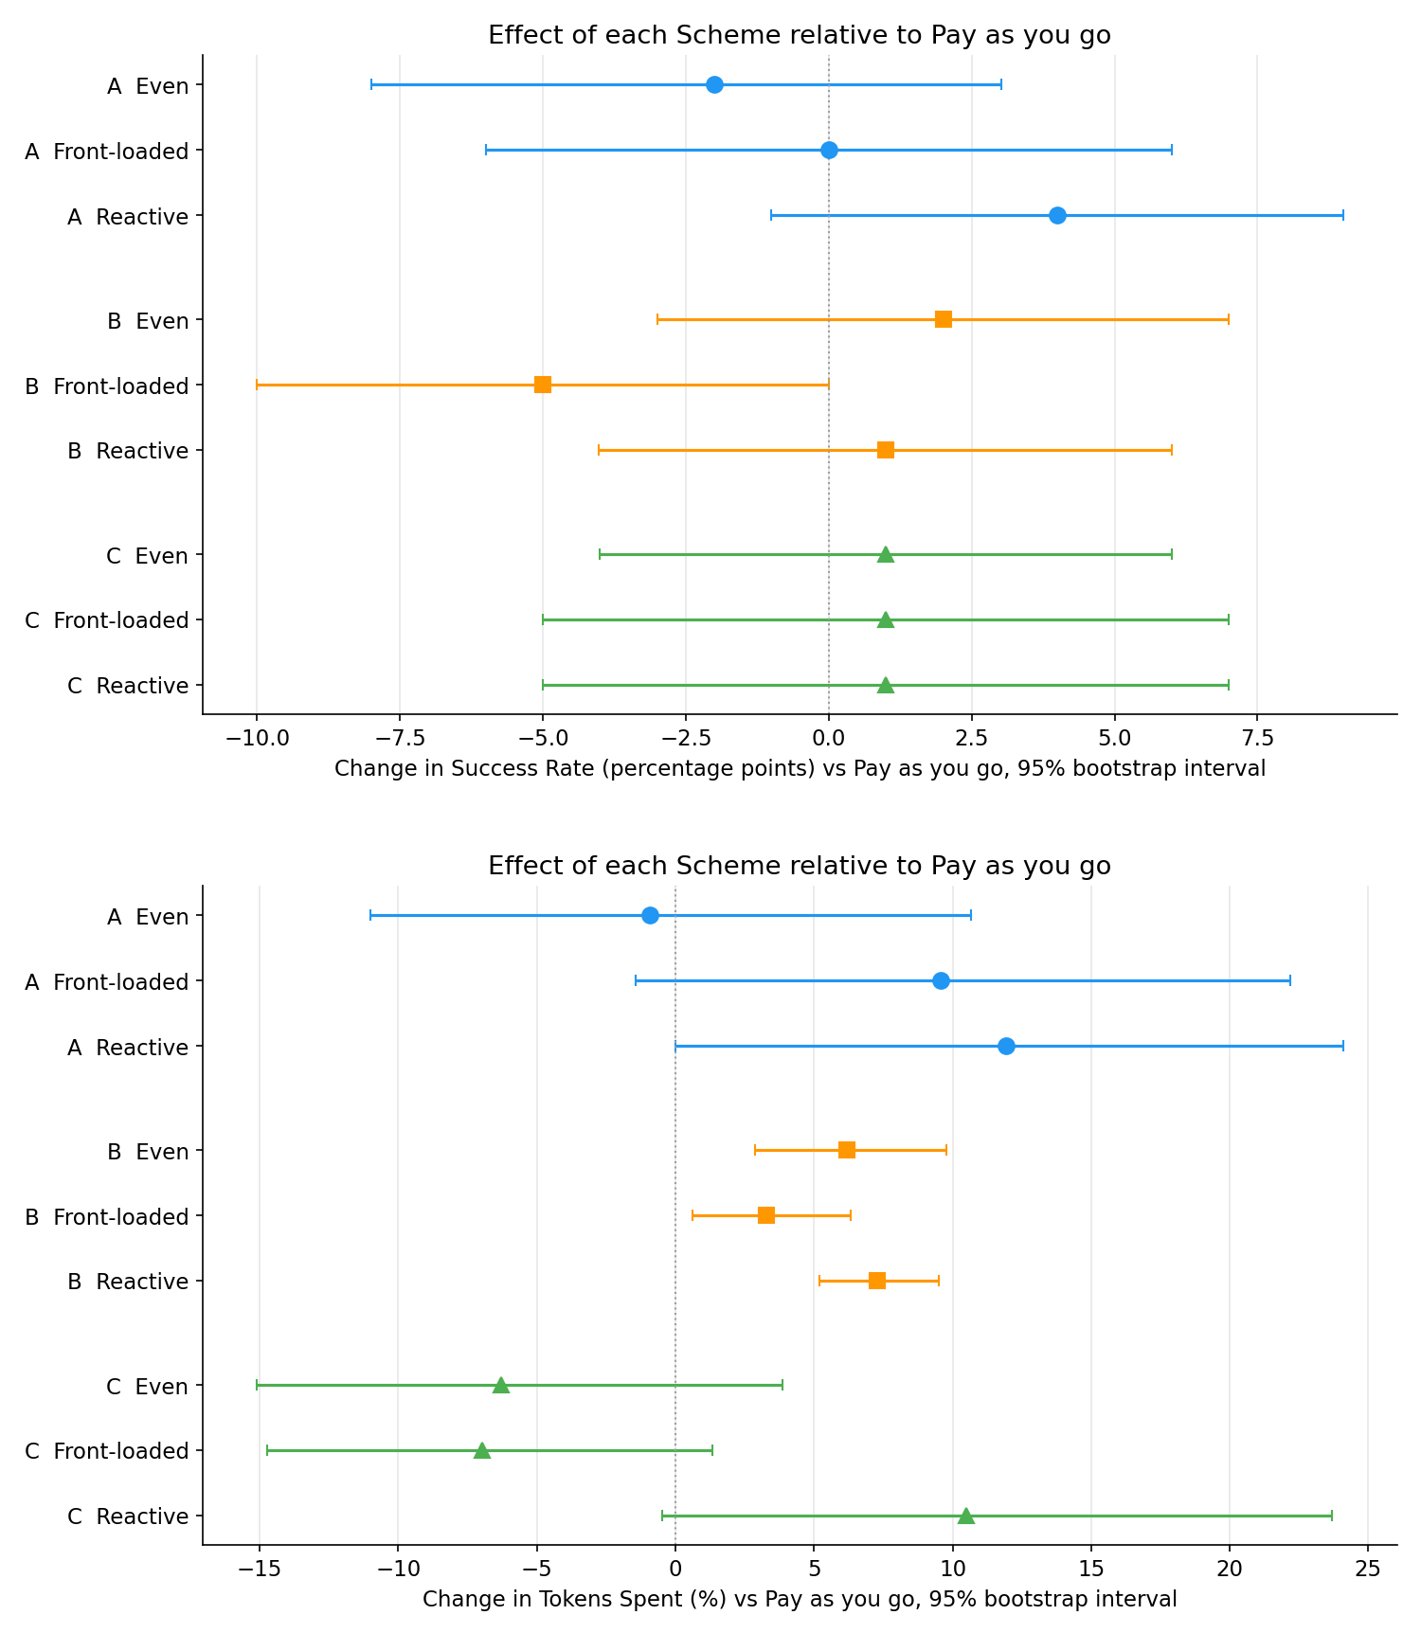
RQ3: allocation within an episode changed cost, not success
Strategy | Scheme | Δ success (pp) [CI] | Δ tokens (%) [CI]
A | Even | −2.0 [−8.0, +3.0] | −0.9 [−11.0, +10.7]
 | Front-loaded | 0.0 [−6.0, +6.0] | +9.6 [−1.4, +22.2]
 | Reactive | +4.0 [−1.0, +9.0] | +11.9 [−0.0, +24.1]
B | Even | +2.0 [−3.0, +7.0] | +6.2 [+2.9, +9.8]
 | Front-loaded | −5.0 [−10.0, 0.0] | +3.3 [+0.6, +6.3]
 | Reactive | +1.0 [−4.0, +6.0] | +7.3 [+5.2, +9.5]
C | Even | +1.0 [−4.0, +6.0] | −6.3 [−15.1, +3.9]
 | Front-loaded | +1.0 [−5.0, +7.0] | −7.0 [−14.7, +1.4]
 | Reactive | +1.0 [−5.0, +7.0] | +10.5 [−0.5, +23.7]
Report Table 4.7 (Appendix): paired bootstrap over 100 read-only tasks at 32k, 2,000 resamples
No scheme changed any strategy's success: none of 18 within-strategy McNemar tests reached 0.0028; every success interval spans zero
B cost more under every scheme (bold): fitting three calls into a per-step allowance trimmed the page on 49% to 78% of steps, and the pipeline then took more steps
A's high-effort schemes raised spend (+9.6%, +11.9%); C's even and front-loaded schemes trended cheaper
The ordering survived every scheme: A and C never differed (p ≥ 0.375); B trailed both under every scheme, significantly for three of the six contrasts at the 0.0042 threshold
Report Figure 4.7: effect of each scheme vs pay-as-you-go, 95% bootstrap intervals (analyse_schemes.py)
Notes:
[Slide 23 · RQ3 allocation schemes · ~35s]
RQ3 ran four spending schemes on a hundred read-only tasks at thirty-two thousand tokens. [Point to the top panel of Figure 4.7.] The change in success relative to pay-as-you-go: every interval spans zero, so no scheme changed any strategy's success. [Point to the bottom panel and the bold rows.] Spend is where the effects are: for the pipeline every scheme cost more, because fitting three calls into a per-step allowance trimmed the page and the pipeline took more steps. How tokens are spread within an episode mattered far less than the decision whether to start one.

Slide 24
How far to trust the results, and what bounded them
What makes the comparison trustworthy
Limitations
✓
Paired design
One backbone model (GPT-5 mini) and three of WebArena's five sites
One collection per cell: run-to-run variance is unmeasured; ±4-point intervals mean A vs C is undetectable, not equal
A's pre-step estimate covers the prompt only, so its cap can be overshot by one step's output (measured and bounded)
Difficulty κ 0.63 overall but 0.43 on pages-to-traverse
RQ3: 100 shopping-heavy tasks; ±9-point intervals cannot detect scheme effects of the size observed
Router trained and tested on the same task population: folds prevent task leakage, not distribution shift
Every comparison is within identical (task, budget) cells: exact McNemar on discordant cells, Bonferroni-corrected, Wilson 95% intervals.
✓
Decontamination
Risk labels and the first-success rule remove carried-over state; RQ3 used read-only tasks only.
✓
Independent difficulty labels
Rubric scored without agent outcomes; κ = 0.63 held out against my hand labels.
✓
Offline to live transfer
Router predicted 91.8% kept / 22.0% saved; live 93% / 20%.
Cost bounded the scope. The EC2 instance cost about US$280 from July to October (≈ US$115 a month during the main collections), plus OpenAI charges for roughly 116 million tokens. That budget allowed one model, three sites and one run per cell.
Notes:
[Slide 24 · Validation and limitations · ~40s]
How much should you trust this? [Point to the left column.] Paired tests within identical cells with Bonferroni correction and Wilson intervals; decontamination of the stateful sites; difficulty labels scored independently of outcomes and validated with kappa; and a router whose offline prediction matched its live behaviour. [Point to the right column.] The limits: one backbone model and three of the five sites; one run per cell, so variance is unmeasured, and four-point intervals mean A against C is undetectable, not equal; a bounded one-step overshoot in A's accounting; kappa of only 0.43 on the pages dimension; and an RQ3 sample too small to detect scheme effects of the size observed. [Point to the cost card.] Cost bounded the scope: about 280 dollars of EC2 time plus API charges for roughly 116 million tokens.

Slide 25
Use of generative AI: five functions, each specified and tested
Script | Function generated from my prompt (Claude Opus 5) | Lines | Checked by
label_tool.py | Consistency check between the hand-labelled gold-set CSV and the unedited gold-set JSONL | 206–250 | Run on the real gold set before it served as ground truth
classify_tasks.py | Self-test of the keyword rules over a hand-checked list of task intents | 263–345 | Self-test passed first time; pattern reused in flag_episodes.py
shared.py | Wilson 95% interval that behaves at zero successes; exact McNemar on discordant cells only | 75–84, 90–97 | Read against Eq. 3.5 and 3.6; zero successes → interval starts at 0; identical strategies → p = 1
compare_abc.py | Bonferroni correction across strategy pairs and difficulty tiers | 123–150, 291–313 | Thresholds 0.05/3 and 0.05/9 recomputed; A vs C (p = 0.065) reported as not detectable, not equal
analyse_schemes.py | Task-paired comparisons: scheme vs scheme (McNemar for success, Wilcoxon signed-rank for tokens) and strategy vs strategy | 114–147, 150–171 | Run inside the full analysis; printouts read for internal consistency across scripts
The pattern, five times
One prompt describing a method I had already chosen, its inputs and the property it had to have
Read line by line against the definition; run on cases with known answers; then run inside the pipeline's own self-tests and the full analysis
None of the five needed correction after review
Everything else is my own work
Harness, strategies, collection, decontamination, annotation and router code
The experiments, the data, the hand-labelled gold set, the trained router and the analyses
Report Table 5.1 and Appendix D.1: prompts, line numbers and what each function taught me; full log in AI_Usage.md
Notes:
[Slide 25 · Use of generative AI · ~35s]
Generative AI was used in the code, within limits that Chapter 5 and Appendix D declare in full. [Point to the table.] Five functions were generated by Claude from my prompts: the gold-set consistency check, the classifier self-test, the Wilson interval and exact McNemar test, the Bonferroni correction, and the paired scheme comparisons. In each case I had already chosen the method and the prompt specified it precisely; each function entered the repository only after I had read it against its definition, run it on cases with known answers, and run it inside the pipeline's self-tests and the full analysis. None needed correction. [Point to the lower card.] Everything else, the harness, the strategies, the router, the experiments, the data and the analyses, is my own work.

Slide 26
Conclusions: under a fixed budget, orchestration must be earned
1
The fixed pipeline never repaid its overhead
2
A Critic that approves 95% of actions is overhead
3
A learned router kept 93% of successes for 20% fewer tokens
A 2.8× per-step cost means B pays before it can earn: nothing at 2k–4k, 7 to 13 points behind A from 8k to 32k, level only at 64k; 2 to 4 times the budget for the same success.
31.5% of spend for 5.1% revisions; review should be conditional on evidence the actor lacks, such as a preceding action error.
Offline RL on logged episodes transferred live. Its lesson was to decide whether to begin, not how to orchestrate; allocation within an episode changed cost, not success.
Recommendations
Further work
Under a fixed budget, default to a single agent; add a planner only where it is seen to loop; invoke a critic only after an action error
Evaluate budget-aware designs against a budget-matched single agent with paired tests and decontamination
A second backbone, the remaining sites, repeated runs to estimate variance
A conditional Critic triggered by action errors; a stop head trained with on-policy data to recover the 36 wrongly declined tasks
The proposal's per-step role router, which needs training data that call the roles in varied patterns
Notes:
[Slide 26 · Conclusions and further work · ~40s]
Three conclusions. [Point to card 1.] Under a fixed budget, orchestration must be earned: the fixed pipeline never repaid its 2.8-times overhead at the budgets tested. [Card 2.] A Critic that approves ninety-five percent of actions is overhead, not safety; review should be conditional on an action error. [Card 3.] A learned router kept ninety-three percent of the single agent's successes for twenty percent fewer tokens, and what it learned was to decide whether to begin rather than how to orchestrate. The recommendations follow directly. Further work: a second backbone, repeated runs to estimate variance, a conditional Critic, and a stop head trained on-policy to recover the thirty-six tasks it wrongly declined.

Slide 27
Thank you
A
B
C
Code, data, trained router and reproduction guide:
github.com/Tbeard04/Token-Budget-Orchestration-Strategies-for-Web-Agents
Thomas Beard | MSc in Artificial Intelligence | Supervisor: Professor Eduardo Alonso
Notes:
[Slide 27 · Close · ~10s]
The code, the dataset, the trained router and a step-by-step reproduction guide are in the repository shown on the slide. Thank you for watching.

